Slide 1

2. Corporate Strategies and Their Marketing Implications
Glory Days
Premium Prices and quality
Biggest share of corporate, R&D and sales excellent resources
Troubles
Internet and Intranet reduced the demand for mainframes
Mission Statement
Moving away from the creation of the technology to the application of the technology
Our Business: e-business engineering, software, and outsourcing services.
Dell solutions of tailored equipment and services
Strategy
50% of R&D budget for internet software development

Slide 2
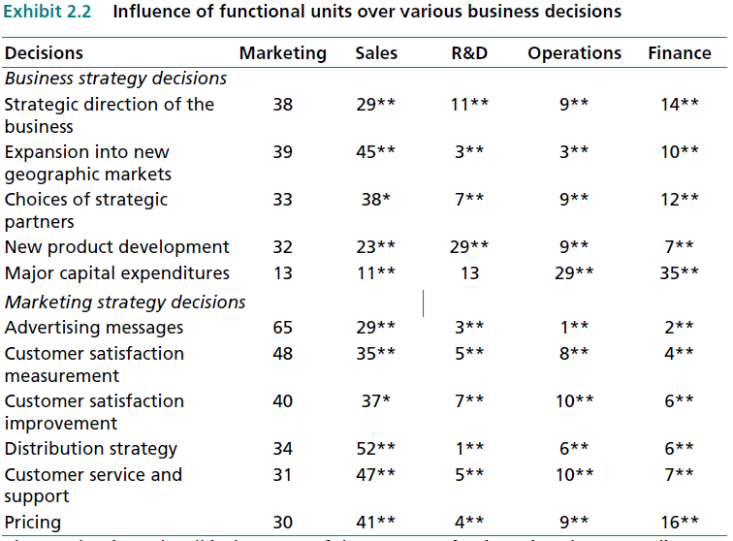
2.1 What Is Marketing’s Role in Formulating and Implementing Strategies?
US corporates are more like this
However some are not

Slide 3
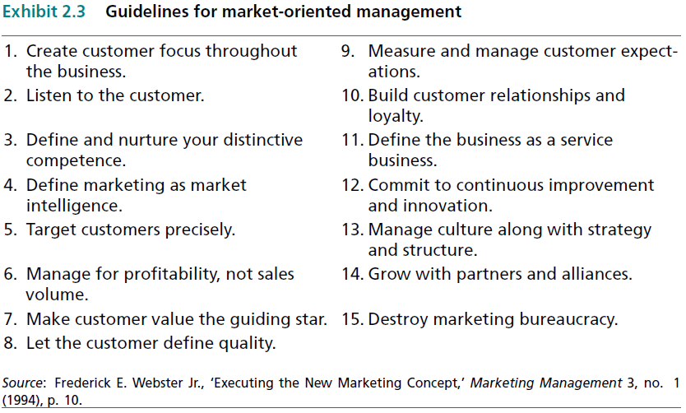
2.1.1 Market-Oriented Management

Slide 4
2.1.2 Does Being Market-Oriented Pay?
Marketing Concept
Profitability
Customer Focus
Cross Functions
Never miss that corner

Slide 5
2.1.3 Factors That Mediate Marketing’s Strategic Role
Factors
Exceptional Competitive Conditions
Industry or market development phase
Inertia of past successful startegy

Slide 6
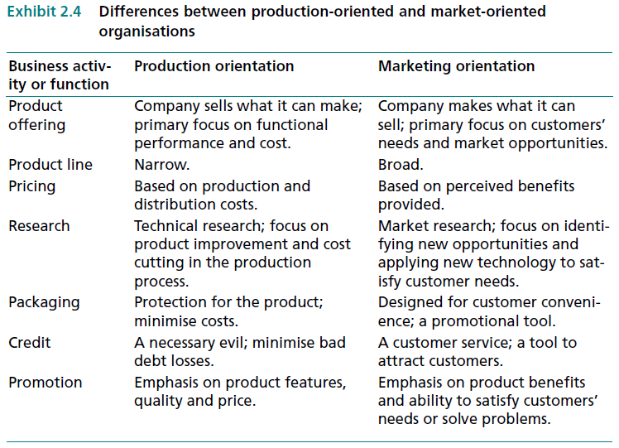
2.1.3.1 Competitive Factors Affecting a Firm’s Market Orientation
New Entrants
Few Competitors
Product Oriented
Capacity Growth
Sales Oriented
Maturity
Marketing Oriented

Slide 7
2.1.3.2 The Influence of Different Stages of Development across Industries and Global Markets
Global
Different maturity
Different rules
Industry
Monopoly
Development
History

Slide 8
2.1.3.3 Strategic Inertia
Success
My way is the best
Shock
Listen to the market

Slide 9
2.2 Three Levels of Strategy: Similar Components But Different Issues
What are strategies
How they implemented over an org

Slide 10
2.2.1 Strategy: A Definition
A strategy is a fundamental pattern of present and planned objectives, resource deployments, and interactions of an organisation with markets, competitors, and other environmental factors.
What
Objectives
How
To implement
Where
To focus

Slide 11
2.2.2 The Components of Strategy
Scope
Number and types of industries, product lines, and market segments
Objectives
KPIs as volume growth, profit contribution, or return on investment
Sustain Competitive Advantage
Position to develop and sustain advantage competitors?
Resources Deployment
Deciding how resources are to be obtained and allocated
Synergy
When the firm’s businesses, product-markets, resource deployments, and competencies reinforce one another

Slide 12
2.2.3 The Hierarchy of Strategies
Strategies
Corporate
Scope
Objectives
Function
Business
Resources
Competitive Edge
Synergy
Scope
Objectives
Resources
Competitive Edge
Synergy
Scope
Objectives
Resources
Competitive Edge
Synergy

Slide 13
2.2.4 Corporate Strategy
Scope
Domain: What businesses should we be in?
Development: Acquisitions, conglomerates … etc.
Targets
Overall corporate objectives such as : Revenue growth, Profitability , ROI, Earnings per share and Contributions to other stakeholders
Resources
Allocation among businesses in the corporate portfolio
Allocation across functions shared by multiple businesses (corporate R&D, MIS)
Edge
Synergy
More corporate R&D; better organisational processes or synergies relative to competitors across all industries
Shared resources, technologies or functional competencies across businesses within the firm

Slide 14
2.2.5 Business-Level Strategy
Scope
Domain: ‘Which product markets should we be in within this business or industry?’
Development : Concentric diversification (new products for existing customers or new customers for existing products)
Targets
Constrained by corporate goals
Resources
Allocation among product-market entries in the business unit
Allocation across functional departments within the business unit
Edge
Synergy
Primarily through competitive strategy; business unit’s competencies relative to competitors in its industry
Shared resources (including favourable customer image) or functional competencies across product market within an industry
Objectives aggregated across product-market entries in the business unit: – Sales growth, New product or market growth, Profitability, ROI, Cash flow and Strengthening bases of competitive advantage

Slide 15
2.2.6 Marketing Strategy
Scope
Domain: Target market definition, Product-line depth and breadth, and Branding policies
Targets
Constrained by corporate and business goals
Resources
Allocation across components of the marketing plan (elements of the marketing mix) for a specific product-market entry
Edge
Synergy
Primarily through effective product positioning; superiority on one or more components of the marketing mix relative to competitors within a specific product market
Shared marketing resources, competencies or activities across product-market entries
Objectives for a specific market-product entry: Sales, market share, contribution margin, and customer satisfaction
Development: Product-market development plan , Line extension and product elimination plans

Slide 16
2.3 The Marketing Implications of Corporate Strategy Decisions
Corporate Strategic Decisions
Objectives & Goals
Allocation of corporate resources
Future Growth
Scope & Mission
Means for gaining a competitive advantage

Slide 17
2.3.1 Corporate Scope – Defining the Firm’s Mission
To provide a useful sense of direction, a corporate mission statement should clearly define the organisation’s strategic scope.
What is our business?
Who are our customers?
What kinds of value can we provide to these customers?
What should our business be in the future?

Slide 18
2.3.1.1 Market Influences on the Corporate Mission
Internal
Mission
Opportunities
Threats
Values
Resources
Competencies
Value for customers
Advantage over competitors
Synergy across its products
Environment
Market

Slide 19
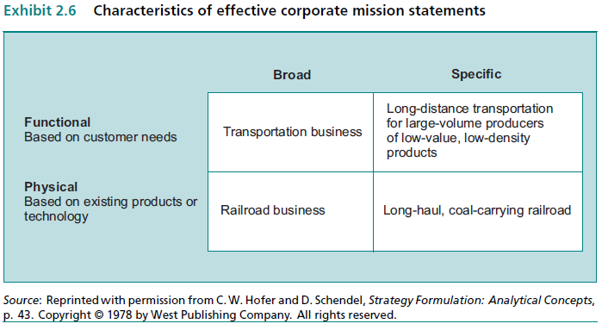
2.3.1.2 Criteria for Defining the Corporate Mission

Slide 20
2.3.1.3 Social Values and Ethical Principles
Formal Stated Ethics
More proactive than low
66% of USA firm have

Slide 21
2.3.1.4 Why Are Ethics Important? The Marketing Implications of Ethical Standards
Unethical practices can damage the trust between a firm and its suppliers or customers,
Such dilemmas are particularly likely to arise as a company moves into global markets
Formalize code of ethics detailed to be used in multi-national firms

Slide 22
2.3.2 Corporate Objectives
S
KPI known and specific
M
Measurable
A
Achievable and has certain hurdle
T
R
Related to strategy
Has time frame

Slide 23
2.3.2.1 The Marketing Implications of Corporate Objectives
Contradicting Objectives
Like ROI and R&D
Set priorities
Different objectives for different SBU
Based on industry maturity stage
Customer-focused objectives
Long-term
Useful for other SBUs
Achieved by non-product aspects

Slide 24
2.3.3 Gaining a Competitive Advantage
Resources
Excellent Sales forces
Marketing
User benefits
Capital
R&D
Relations
IT systems
Marketing research
Lower price
Better quality
Recognized brands

Slide 25
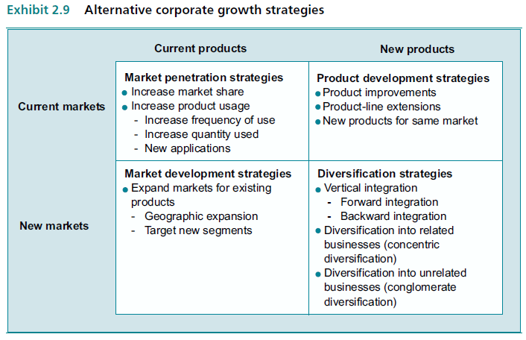
2.3.4 Corporate Growth Strategies

Slide 26
2.3.4.1 Expansion by Increasing Penetration of Current Product-Markets
Improve Products
Lower prices
Ads
Plant loyalty

Slide 27
2.3.4.2 Expansion by Developing New Products for Current Customers
Product Line Extension
New Products
Improvements

Slide 28
2.3.4.3 Expansion by Selling Existing Products to New Segments or Countries
New Segments
Sponsors
Promotions
New Ground
New markets
Chances

Slide 29
2.3.4.4 Expansion by Diversifying
Diversifying
Vertical Integration
Same dist chain
Forward
Supplier take over wholesaler
Backward
Wholesaler take over supplier
Concentric
Same business
Conglomerate
Different field

Slide 30
2.3.4.5 Expansion by Diversifying through Organisational Relationships or Networks
Coalition
Financial institutions
Distributors
Grouped around a large trading company
Manufacturing
firms

Slide 31
2.3.5 Allocating Corporate Resources
Profitable Business
Needs to get resources from
Losing Business
Needs help
Portfolio models
Value-based planning

Slide 32
2.3.5.1 Portfolio Models
These models enable managers to classify and review their current and prospective businesses by viewing them as portfolios of investment opportunities and then evaluating each business’s competitive strength and the attractiveness of the markets it serves.

Slide 33
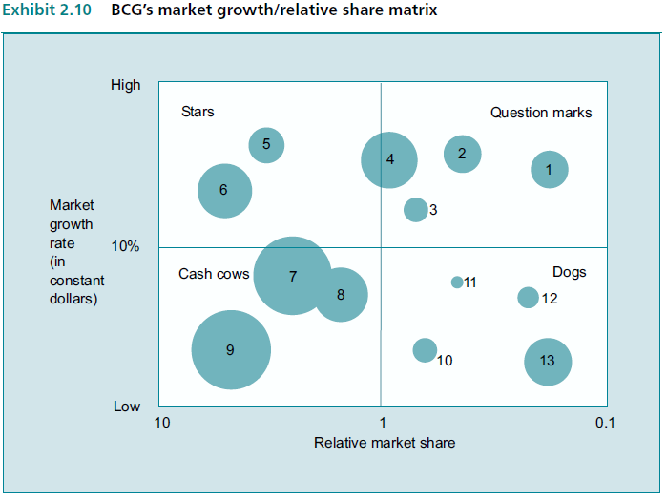
The Boston Consulting Group’s (BCG) Growth-Share Matrix
Represents the future expansion possibilities for the SBU
Represents the competitive advantage of SBU

Slide 34
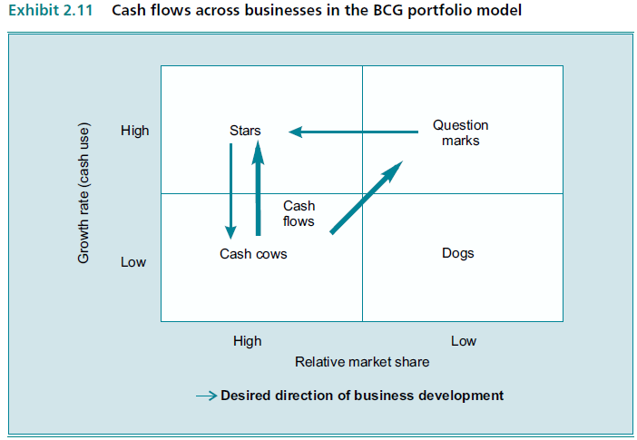
Resource Allocation and Strategy Implications
The future wealth
Might turn into dog or star
Rich and stable
Sell if you can

Slide 35
Limitations of the Growth-Share Matrix
Limitations
Inaccurate indicator of overall competitive advantage
Inaccurate assumption of SBUs independence
Inaccurate indicator of attractiveness
Very sensitive of how axis are measured
Pumping money might not be the solution

Slide 36
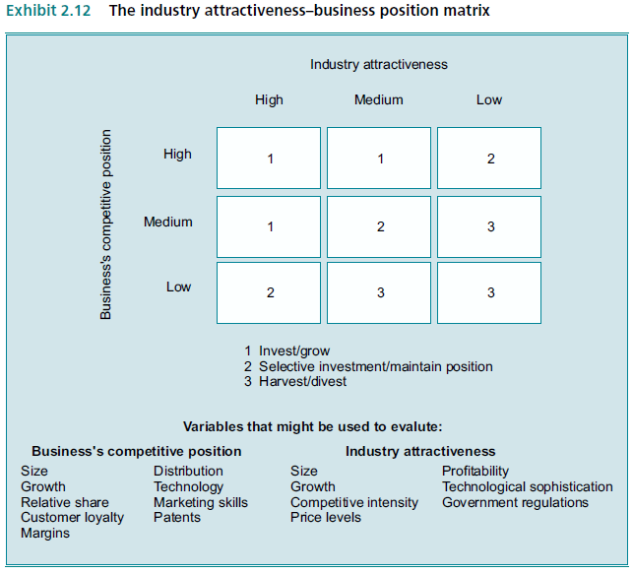
Alternative Portfolio Models
Define Elements
Weights
Combine
Fill in the boxes

Slide 37
2.3.5.2 Value-Based Planning
Provides guidance on how to invest
Assesses economic value
Estimate shareholder value
Likelihood of returns more than capital

Slide 38
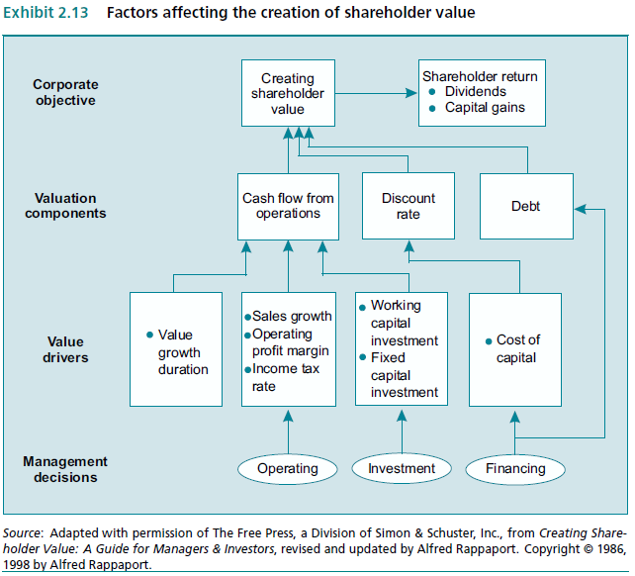
Discounted Cash Flow Model
After how many years this strategy’s return will be grater than capital invested

Slide 39
Some Limitations of Value-Based Planning
Hopes
Fears
Evaluate not propose
Overestimate
It is a tool after all
Underestimate

Slide 40
2.3.6 Sources of Synergy
Magnified Gain
Products
Market
Business

Slide 41
2.3.6.1 Knowledge-Based Synergies
Knowledge Transfer
From SBU to another
From function to another
Competence Transfer
As in Cannon cameras to office copiers
Shared R&D
Efficient

Slide 42
2.3.6.2 Corporate Identity and the Corporate Brand as a Source of Synergy
Communications, impressions and personality projected by an organisation.
Mission
Values
Competencies
quality and design of its goods
marketing communications
Actions of its personnel
image
Image of corporate activities

Slide 43
2.3.6.3 Corporate Branding Strategy – When Does a Strong Corporate Brand Make Sense?
Branding
One Brand
(IBM)
Several Brands for close products
(Volkswagen)
Several Brands for different products
(Unilever)
To be used as synergy source when products and services are interrelated and primary resources are generating similar levels of quality

Slide 44
2.3.6.4 Synergy from Shared Resources
Efficiency
Risk of infexibility

